Slide 1
What’s So ‘Great’ About National Wealth Center?

Slide 2
#1. 100% Commissions!

Slide 3
#2. Great Products!

Slide 4
#3. Break Even With Just 1 Referral!

Slide 5
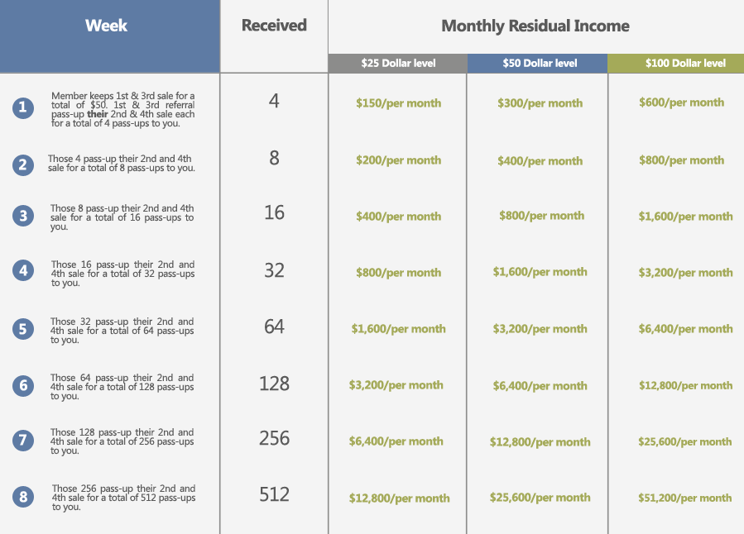
#4. Best Compensation Plan In the Industry!

Slide 6
#5. Access To National Savings Center!

Slide 7
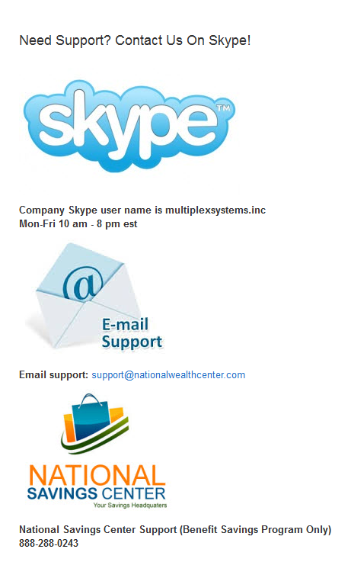
#6. Great Member Support

Slide 8
#7. LONGEVITY & STABILITY

Slide 9
Sound Good? Well Check This Out…

Slide 10
For More Information, Just Go To:
www.thenationalwealthcenterreview.com
My Email:
idwithjames@gmail.com

