Slide 1
National Wealth Center Vs MLM

Slide 2
What’s The Difference?

Slide 3
National Wealth Center is an Affiliate program

Slide 4
MLM or MultiLevel Marketing are NOT Affiliate programs

Slide 5
But Aren’t they both the same?

Slide 6
Let’s Look at the Compensation plan of these 2 models:

Slide 7
Affiliate Marketing Programs Revolve around Making Sales or Referrals

Slide 8
Affiliate Marketers Do not have to have a minimum point or volume to make money

Slide 9
All MLM programs require the distributors to have a minimum point or purchase to be compensated

Slide 10
This is usually anywhere between $125-$200 monthly and you cannot receive compensation if this is not met

Slide 11
In the case of National Wealth Center, all you need is a $25 membership. That’s it.

Slide 12
Let’s look more deeply into the comp plans of National Wealth Center vs MLM

Slide 13
Let’s Look at Comp Plan of a Traditional MLM

Slide 14
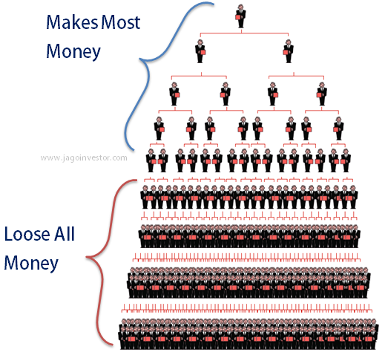

Slide 16
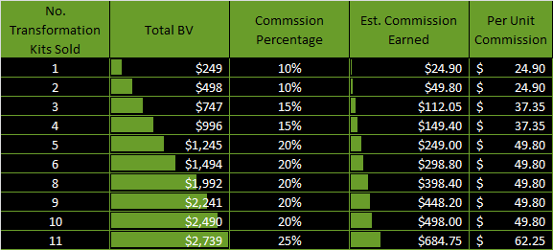

Slide 17
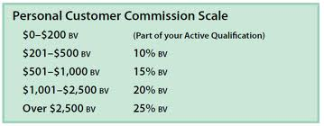

Slide 18
Now Let’s Look At National Wealth Center’s Compensation Plan:

Slide 19
National Wealth Center Only Costs $25…

Slide 20
First and Foremost…National Wealth Center is a 100% Commission Based Program…

Slide 21
With National Wealth Center, You BREAK EVEN with Just 1 Referral!

Slide 22
National Welath Center Revolves Around the Power of 4 – Finding Just 4 Business Partners with $25…That’s It…

Slide 25
This Just Continually Duplicates and Your Income Compounds with Our Reverse 2 Up Compensation System

Slide 26
That’s How EASY This Is! To Learn More Just Go To: www.thenationalwealthcenterreview.com

